Slide 1

Exploring the Latest T-SQL Enhancements
Dustin Dorsey

Slide 2
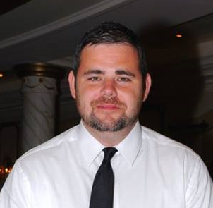
Who am I?
Director of Data Management for Lifepoint Health (Fortune 500 company)
Email - Dorsey.Dustin@att.net
LinkedIn – linkedin.com/in/dustindorsey
Twitter - @SQL_DD
Blog - https://dustindorsey.com/
Github - https://github.com/dustin-dorsey
I have been working with SQL Server for over a decade
Active speaker and blogger

Slide 3




Connect with PASS
#sqlpass @sqlpass
@passcommunity
Sign up for a free membership today at PASS.org

Slide 4
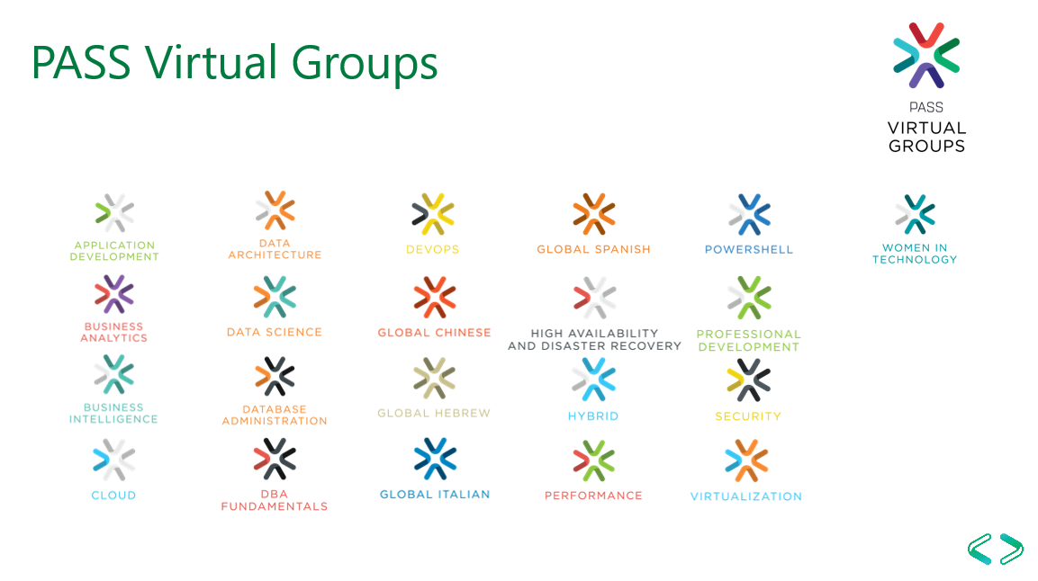

Slide 5


Slide 6
Agenda
Look at some of the new T-SQL stuff that has been added to SQL Server in the most recent releases
Discuss potential considerations, use cases or gotcha’s that you may need to be aware of

